Slide 1
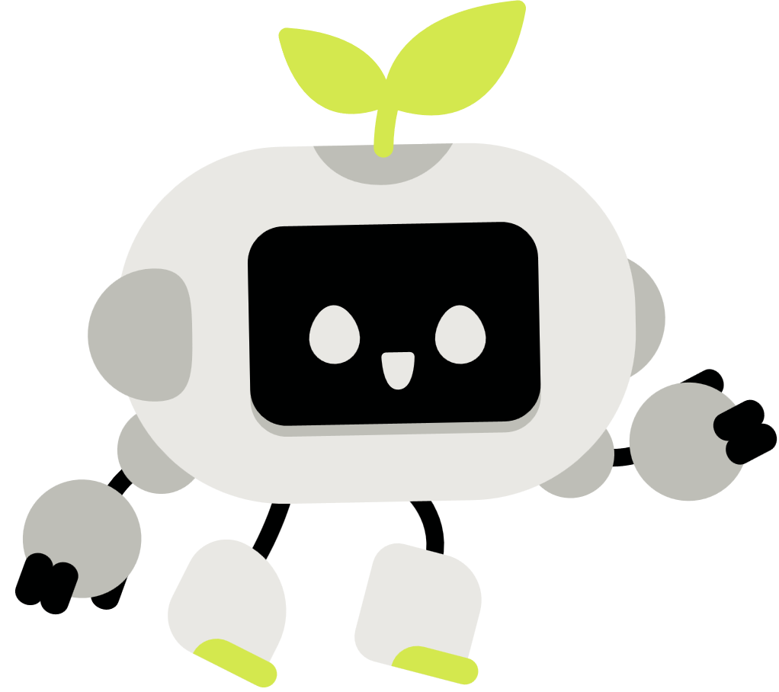


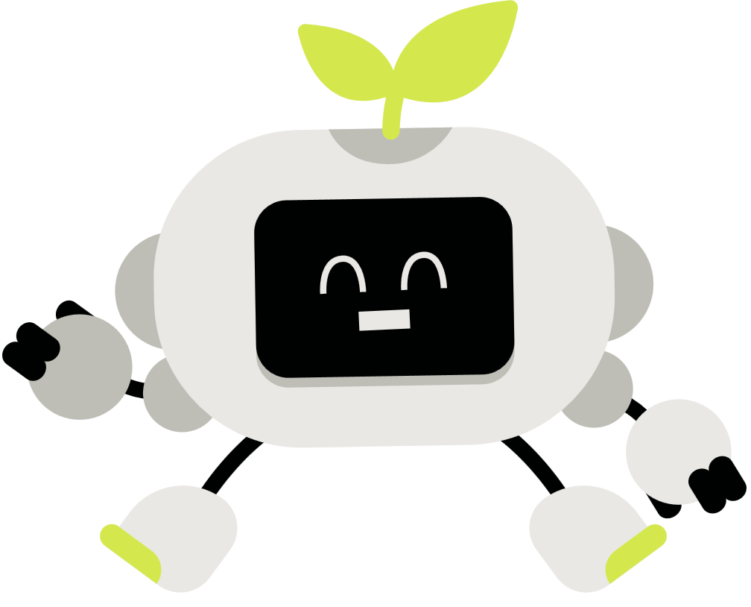

JOURNEY OF ARTIFICIAL INTELLIGENCE
Presented By : Group 2 Guided By : Shri Sanjay Singh

Slide 2

Table of Contents
Artificial Intelligence – Introduction
Evolution of AI
Turing Test
Chinese Room Test
Infrastructure of AI
Uses and Applications
Advantages and Disadvantages
AI tools and Ecosystem
Two facets of AI
Ethics and Responsibilities

Slide 3

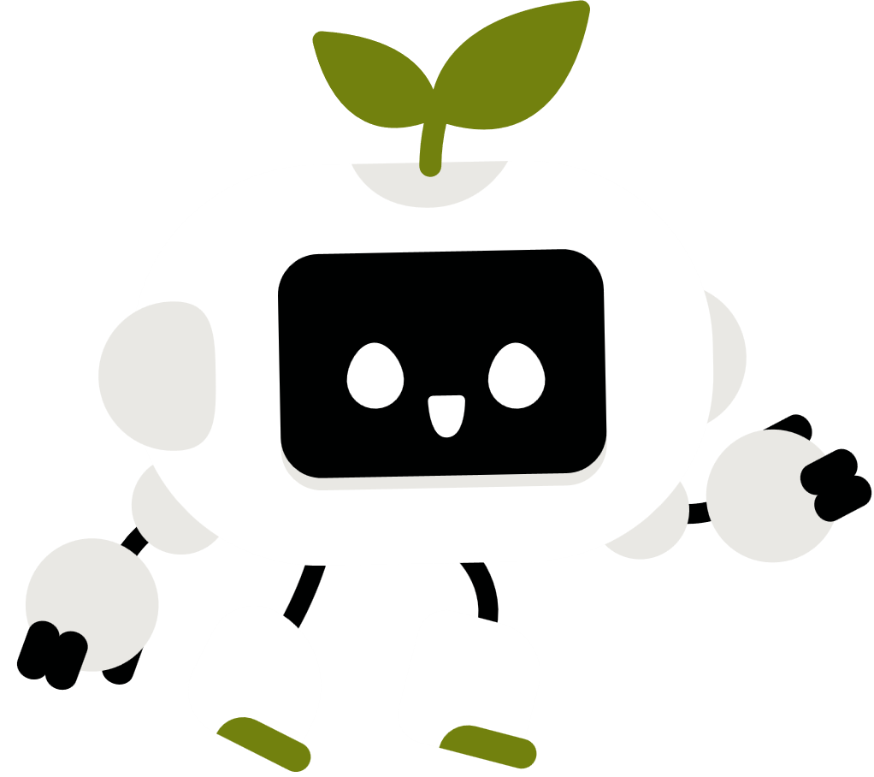
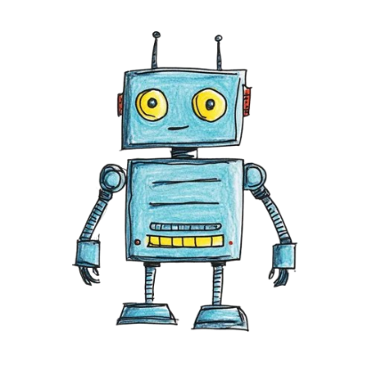
ARTIFICIAL INTELLIGENCE
What is AI?
Refers to ability of machines to learn, think and make decisions like humans.
Why Matters to us?
Automates boring tasks.
Predicts and personalized.
Speed up decision Making.
Powers apps we use daily.
Notes:
Simple Meaning: AI= Human like intelligence in machines.

Slide 4
EVOLUTION OF AI
1950
Alan Turing Test
1970- 80
Early AI/ Expert Systems
2012 Deep Learning Breakthrough
1
2
3
4
5
6
1956
AI Named by John McCarthy
1997 Deep Blue Defeats Kasparov
Present Generative AI Era

Slide 5
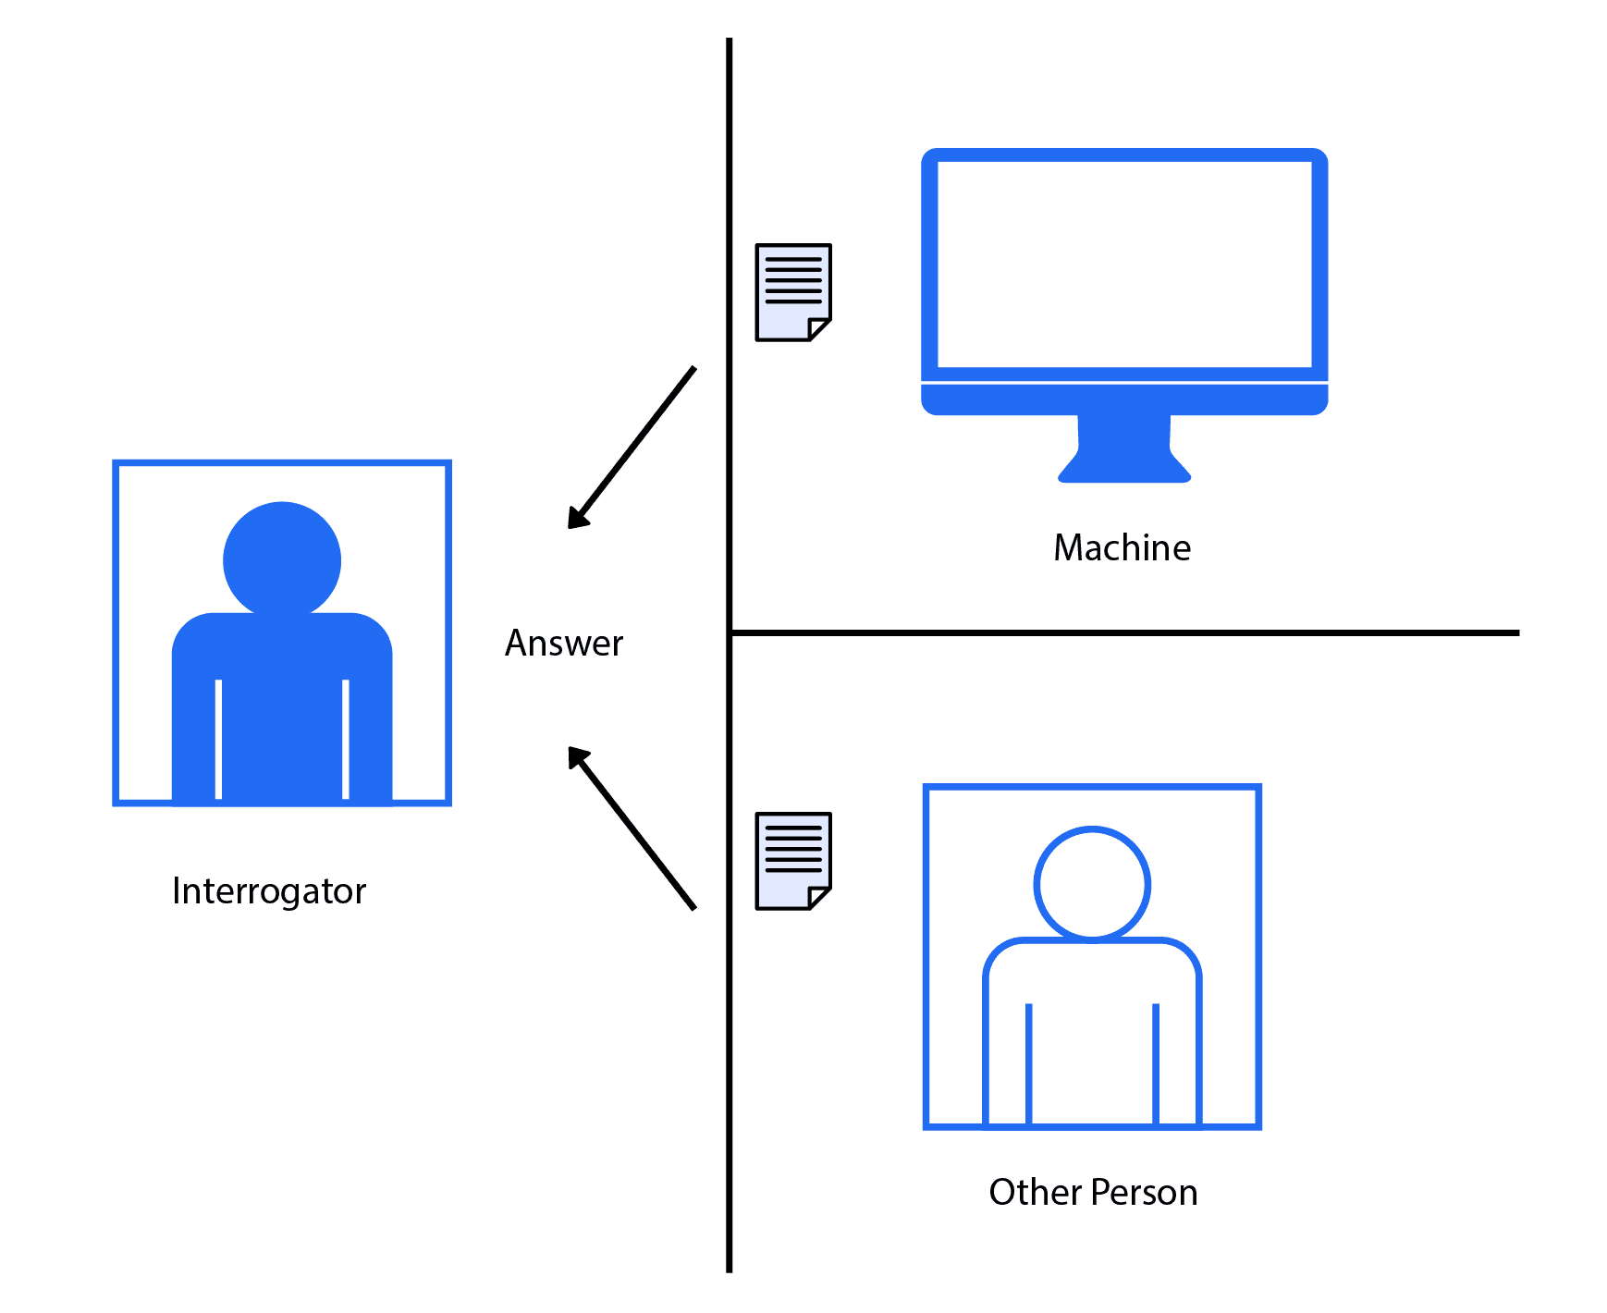
Turing Test
Proposed by Alan Turing in 1950s.
During the test, the human interrogator asks several questions to a computer and human.
Based on the answers , the interrogator attempts to determine which player is a computer and which player is a human respondent.

Slide 6
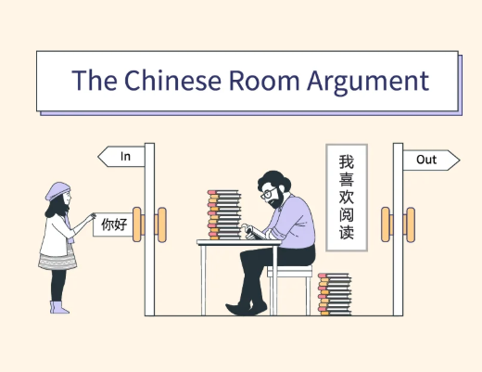
Chinese Room argument
Proposed by John Searle in 1980.
A challenge to Turing Test i.e. true intelligence.
Explains that a machine can give correct answers by following rules without truly understanding them.
Says that behaving intelligently does not mean the system actually knows or thinks like a human.
Behaving like a human ≠ thinking like human

Slide 7
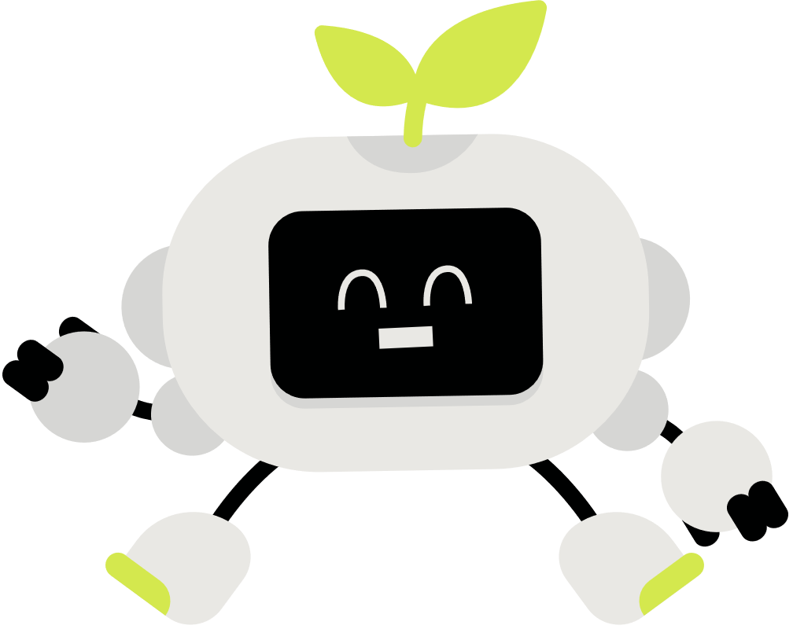
INFRASTRUCTURE OF ARTIFICIAL INTELLIGENCE

Slide 8
Advanced Computing Power
AI Platforms & Model Ecosystems
Data Pipelines & Storage
Cybersecurity & Trust Layer

Slide 9
USERS AND APPLICATION OF ARTIFICIAL INTELLIGENCE

Slide 10
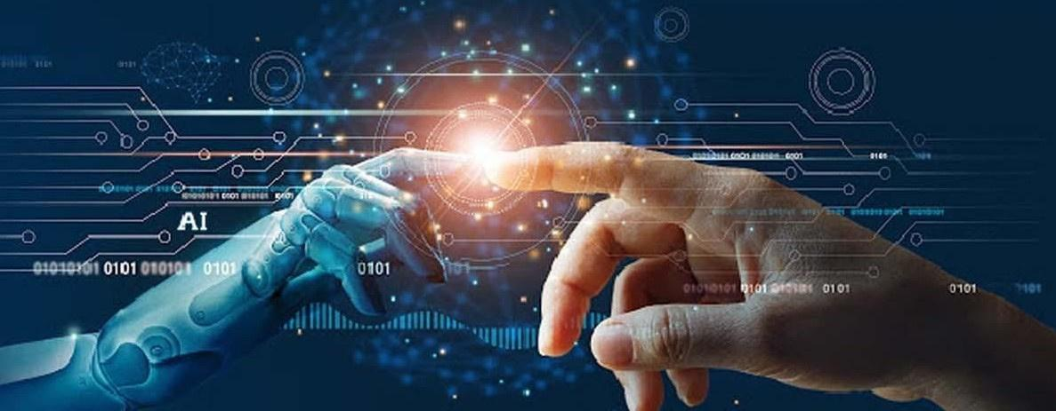
Zoom (Communication & Collaboration)
Canvas (Education & Training)
Adobe (Creative & Media)
Pharmacy & Healthcare
Stock Market & Finance
E-Commerce

Slide 11


ADVANTAGES

Slide 12
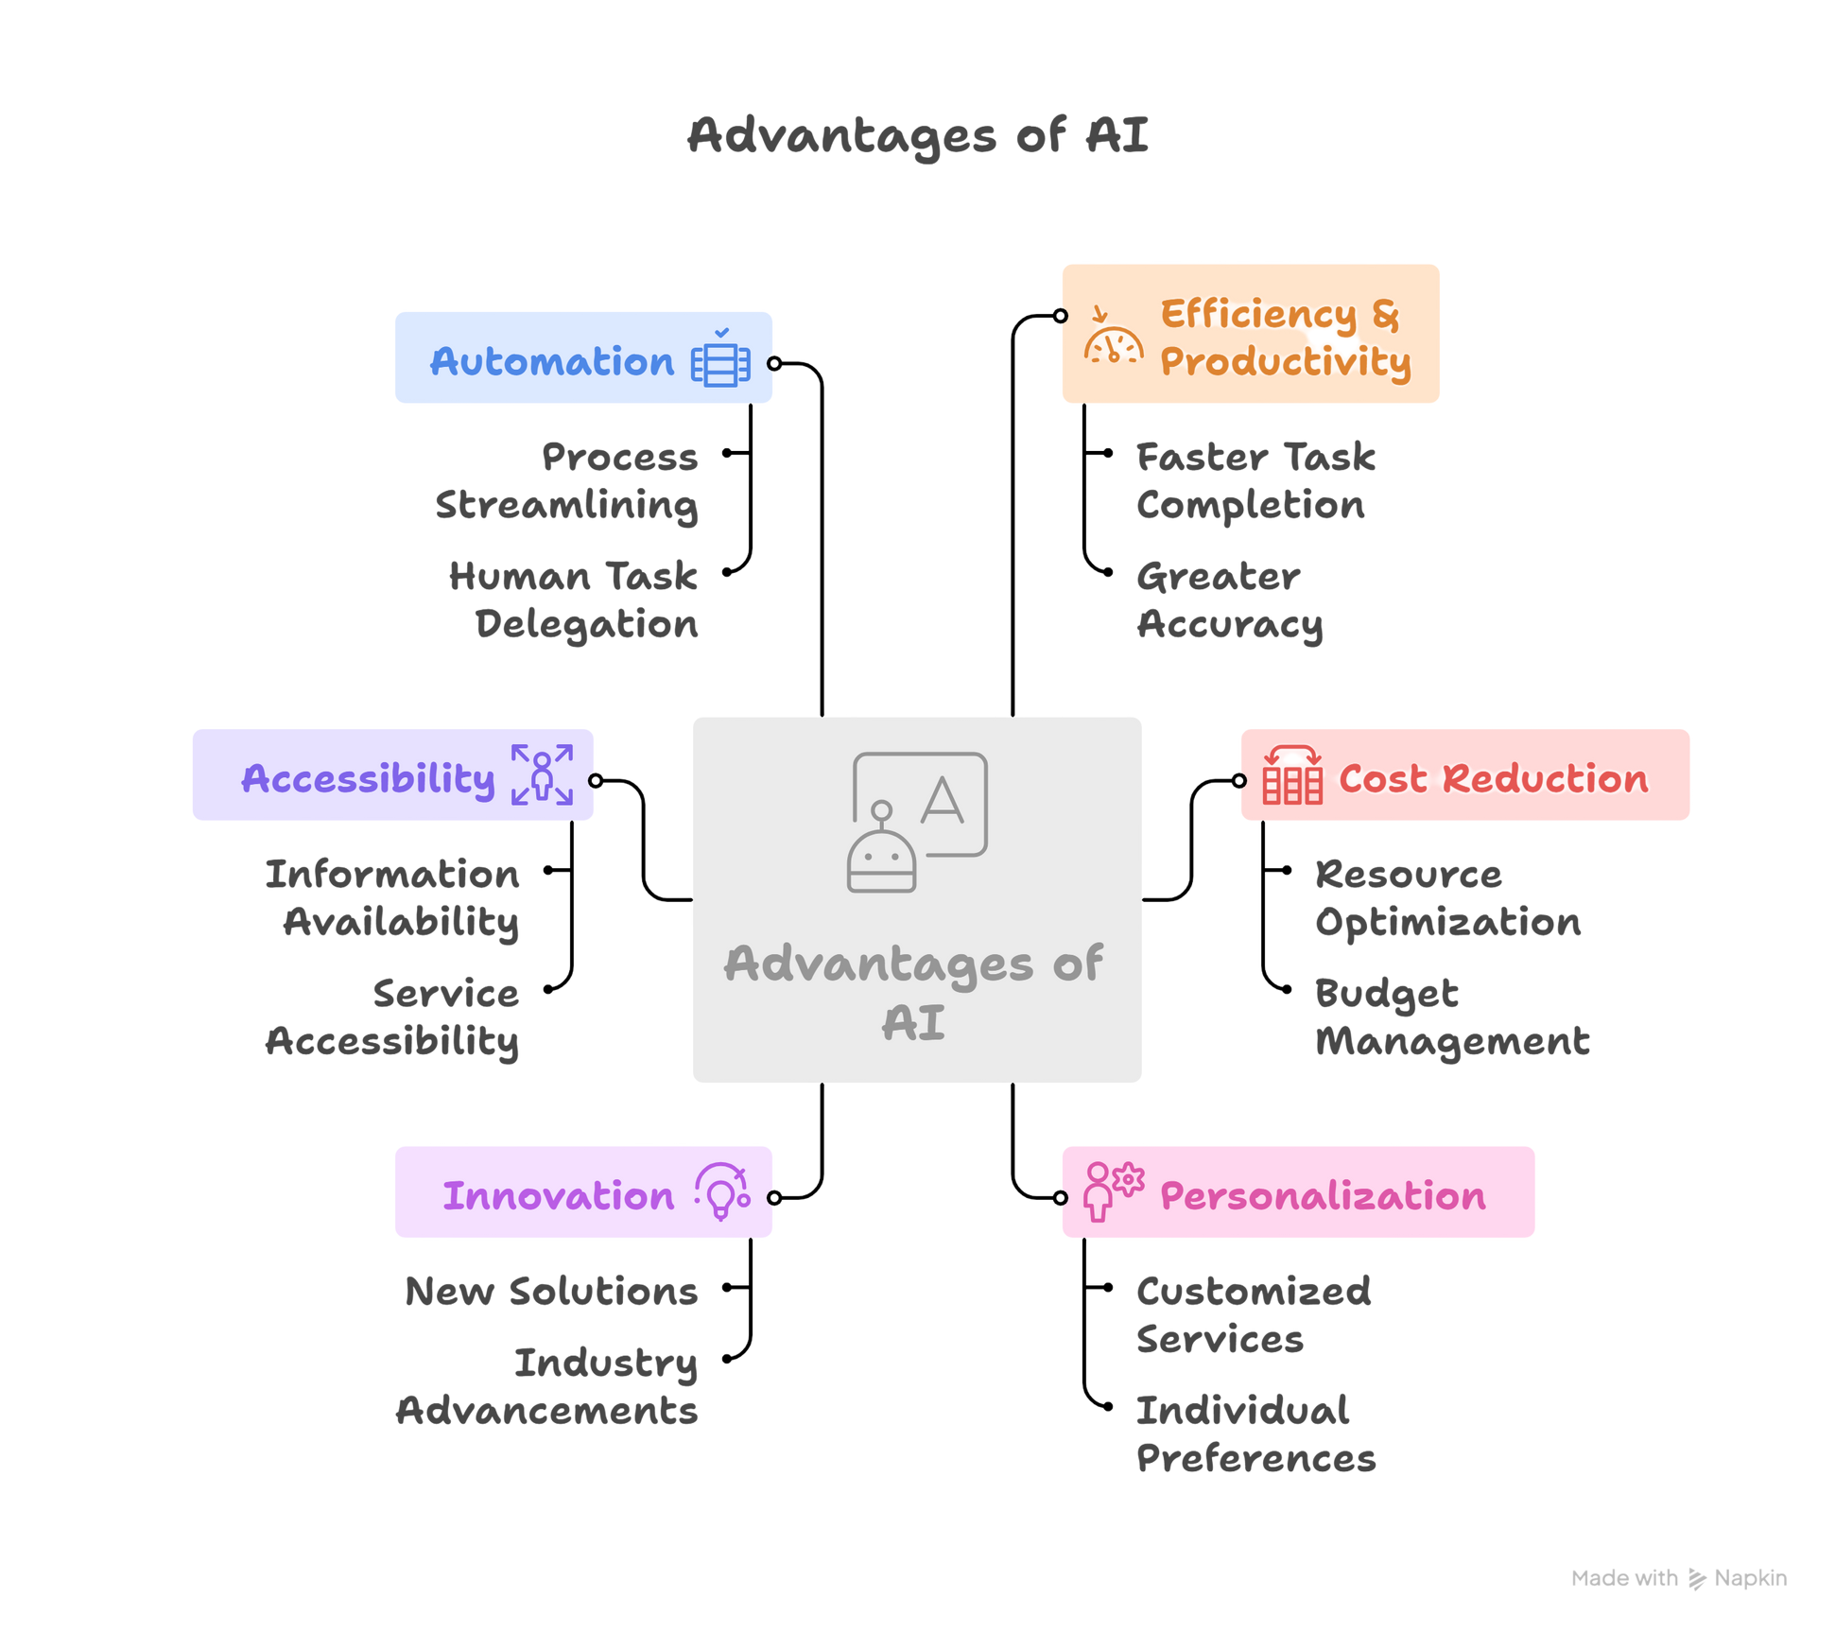

Slide 13
DISADVANTAGES

Slide 14
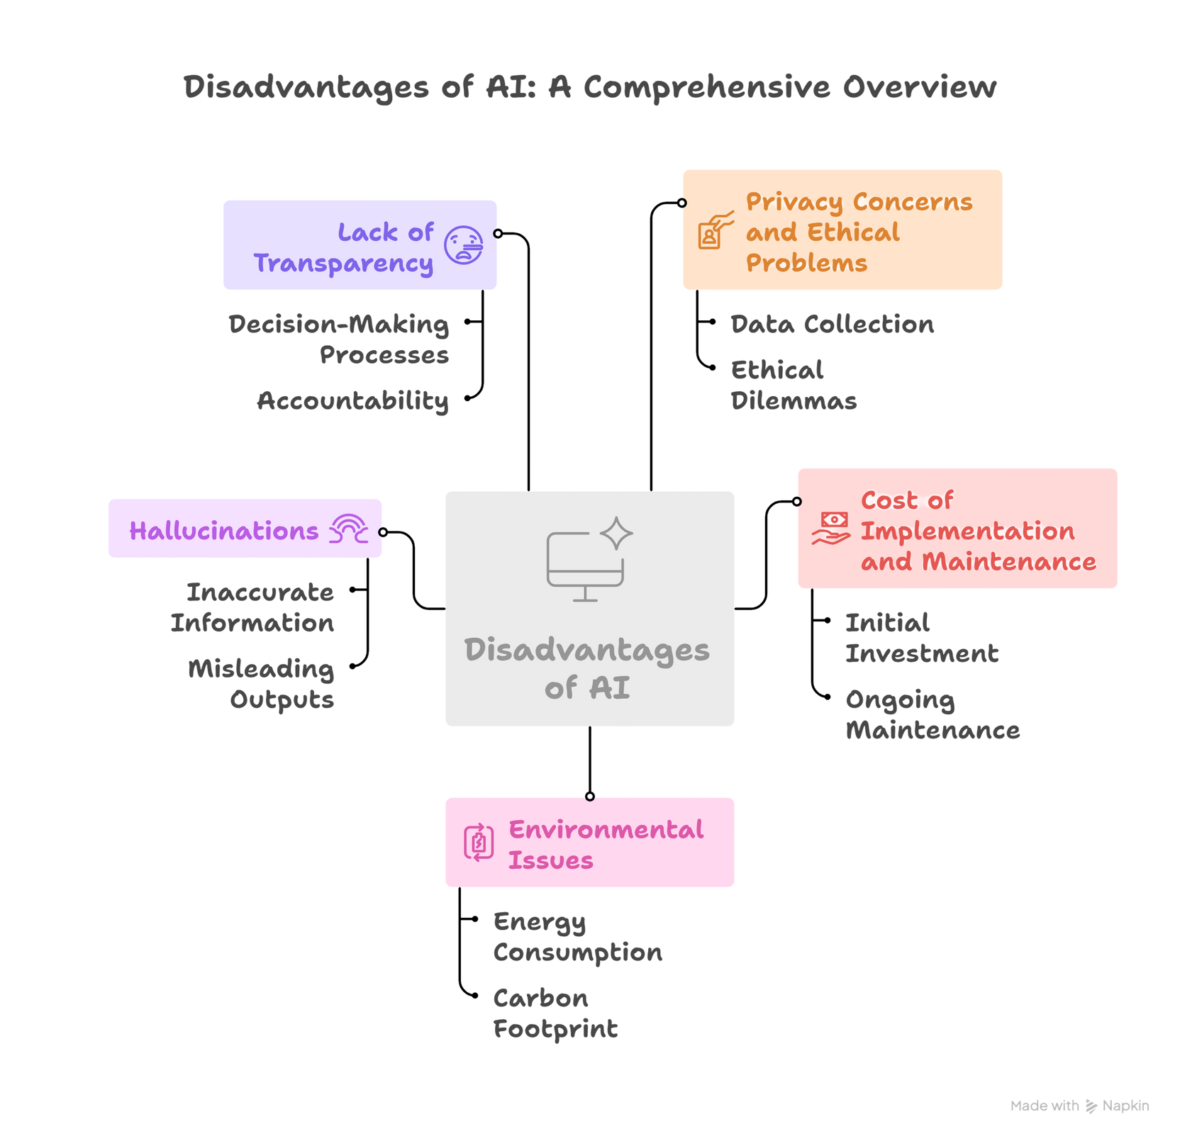

Slide 15
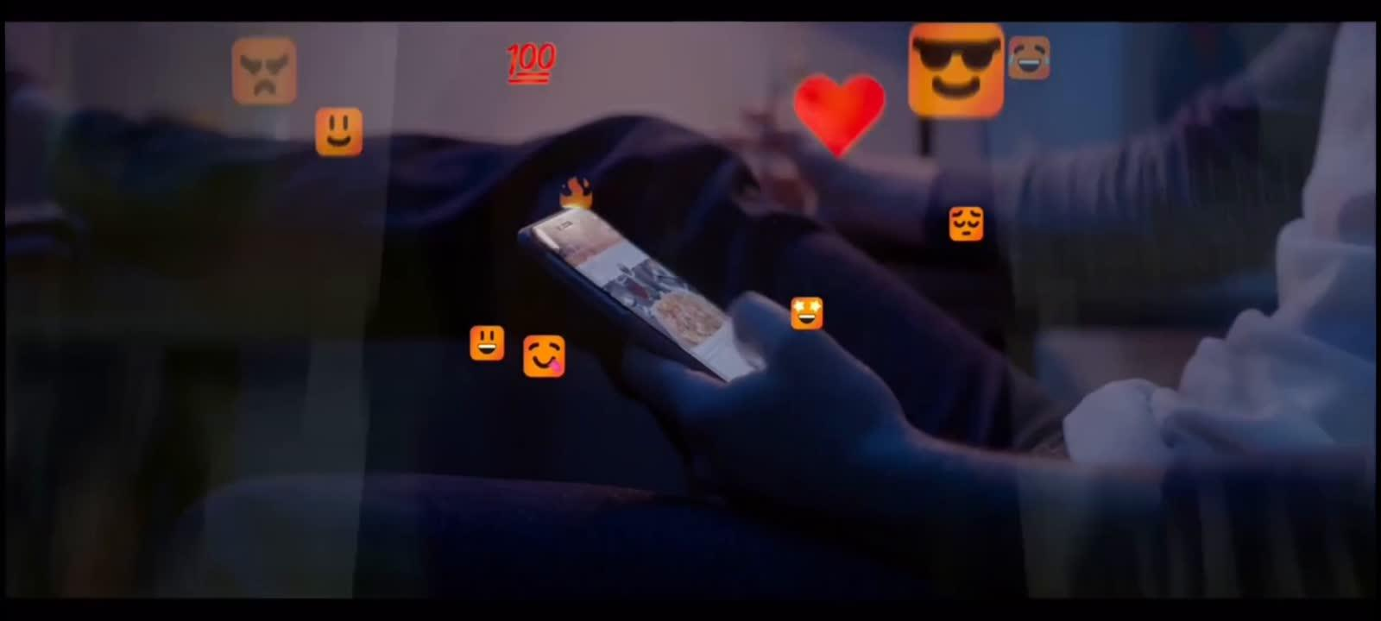

Slide 16
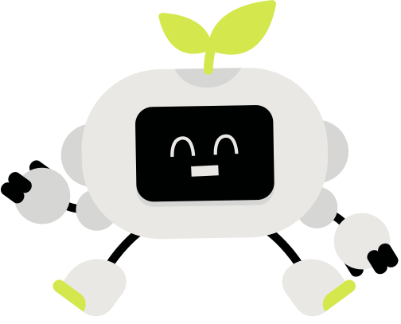


AI Tools
ECOSYSTEM
Enterprise Adoption
78% of organizations use AI in at least one business function
Generative AI
Adoption
71% of organizations regularly use generative AI (up from 33% in 2023)

Slide 17


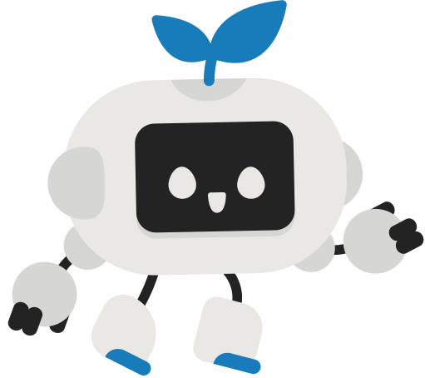






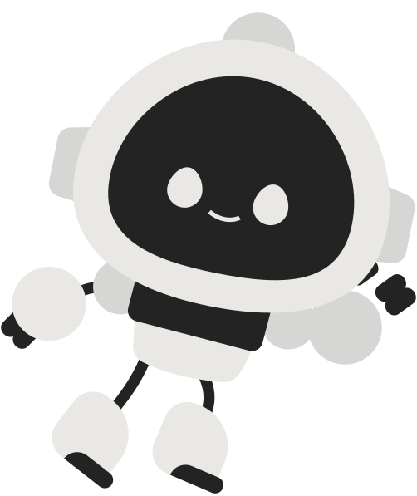
Standalone Tools
Stable diffusion - images from text
GPT (Generative Pre-trained Transformer)
Synthesia ai - text-to-video
DALL-E (Text-to-Image Generation)
Google Imagen 3 - AI image generation

Slide 18
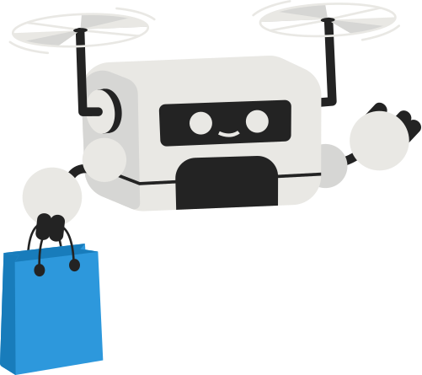



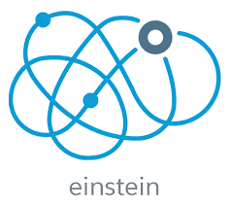

Integrated AI Tools
Microsoft 365 Copilot
Google Duet AI
Salesforce Einstein
Infodata 04
Enhances productivity across Microsoft apps
Real-time insights, predictive text for documents
AI-driven CRM, lead scoring, customer segmentation
310+ AI-powered scenarios

Slide 19



Customized AI Solutions
TensorFlow Enterprise:
Custom ML models, enterprise-grade support
MindStudio
Low-code/no-code platforms
Google Vertex AI:
Tools for training, tuning, deploying ML models

Slide 20
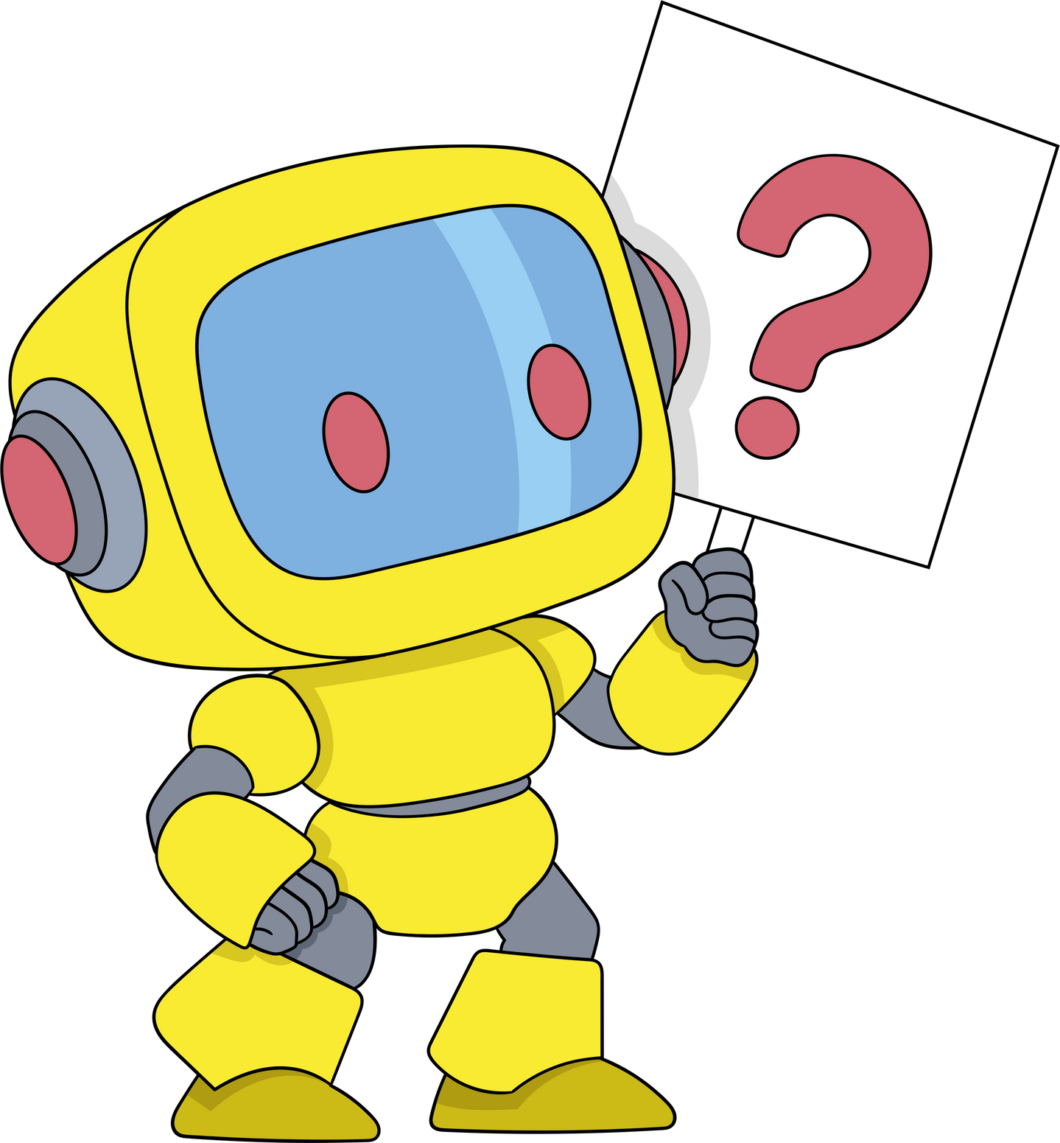
THE TWO
FACES OF AI

Slide 21
FIRST PHASE
AI flood forecasting protects 700M people in 100 countries with 7-day warnings, GraphCast predicts extreme weather
AI diagnoses cancer faster than doctors, predicts disease outbreaks
Climate & Disaster Prevention
2024: Healthcare Revolution
real-time translation breaks language barriers across 200+ languages
66% physicians using AI tools, personalized learning platforms
Education Transformation
Universal Communication

Slide 22



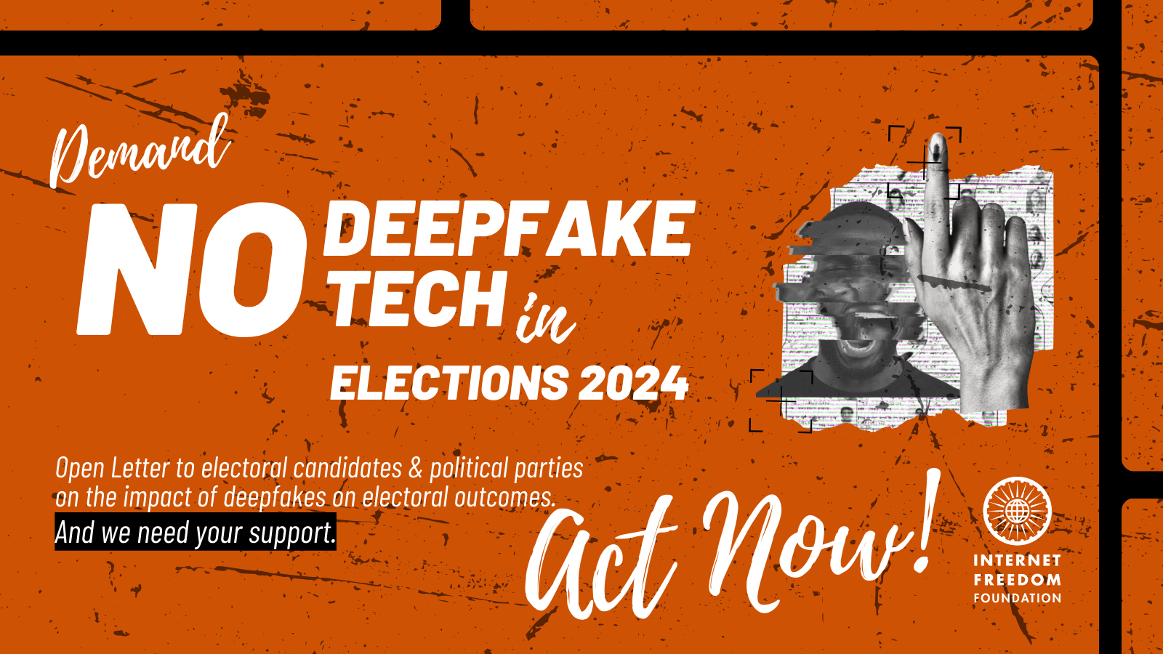
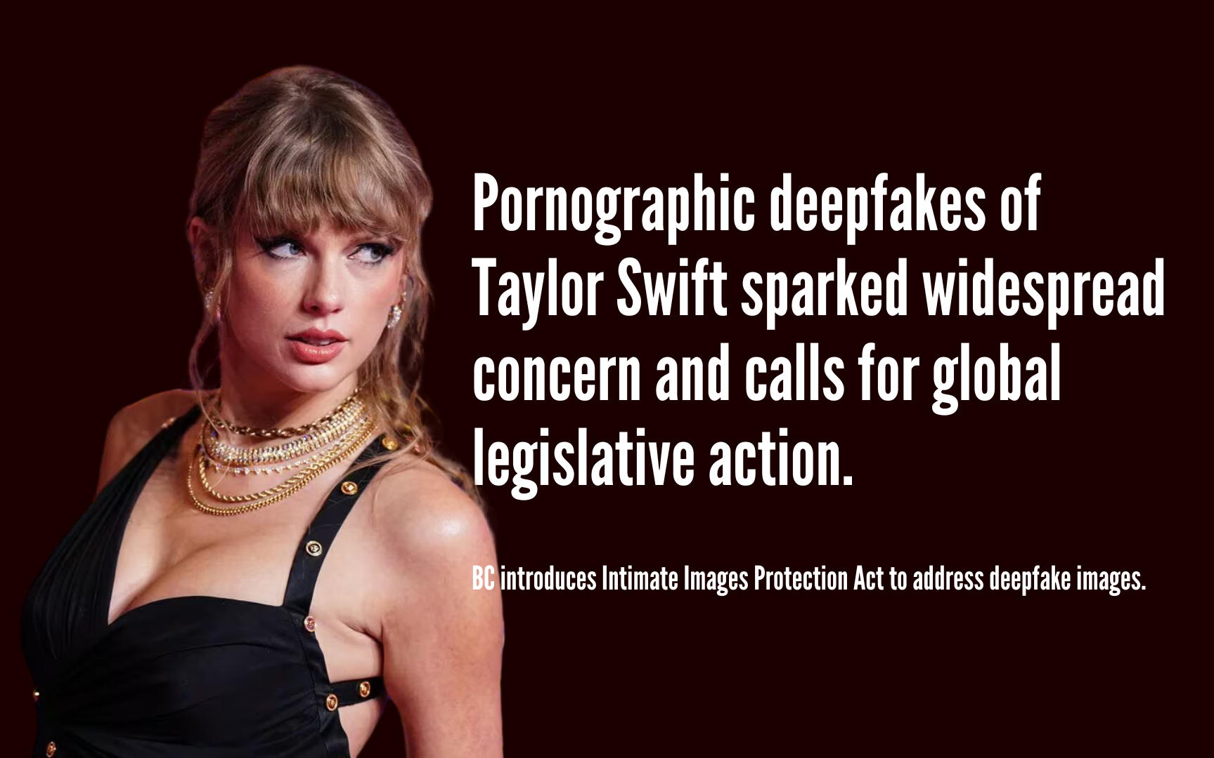

SECOND PHASE

Slide 23
The Dual Edge of AI:
AI doesn't ask permission—it takes your face and makes it say anything, anywhere.
If AI can create your voice to sing, it can also make you confess to crimes you never committed.
AI gave us personalized medicine. It also gave us personalized blackmail.
If AI can add a saree, don't forget—it can remove it too.
The line between innovation and violation? Just one click.

Slide 24

Only 58% of organizations have conducted preliminary AI risk assessments (PwC 2024)
68% of Americans worry about AI being using unethically decision-making
0
ETHICAL
1
THE WORD OF AN HOUR

Slide 25



ETHICS & RESPONSIBLE AI PRACTICES
Human Values Cannot Be Outsourced to Machines
AI's Current Harms: Environmental & Copyright Issues
maintain ultimate human responsibility and accountability in AI decisions
Training BLOOM (a large language model) emitted the same CO2 as driving a car 5 times around the planet
Hold tighter to human ethics as machine intelligence grows
Source: Zeynep Tufekci, TED Talk
Source: Sasha Luccioni, TED Talk

Slide 26
ETHICS & RESPONSIBLE AI PRACTICES
Source: Dr. Joy Buolamwini, MIT, TED Talk
Source: The Urgent Risks of Runaway AI, TED Talk
Power Dynamics in AI Development
The Urgent Risks of Runaway AI
It's not just about fixing bias in algorithms
AI systems like ChatGPT can create false narratives with fabricated evidence, making it difficult to distinguish real from fake information
Who's building AI, who benefits from it, and who gets harmed by it?
Democratize AI development, include affected communities in decision-making from the start
Misinformation machines threaten democracy and elections

Slide 27
CONCLUSION
Every 5 minutes, someone's reality becomes someone else's nightmare — the question is:
when is your turn?

Slide 28
THANK YOU

